Slide 1
PE Determiner Portal Registration and Log on Workshop
Conduent
Government Healthcare Solutions

Slide 2
Purpose
This training will provide step by step instructions for Presumptive Eligibility Determiners on how to register to be an active user on the New Mexico Medicaid Web Portal.
PE Determiner Portal Registration Workshop
Notes:
Presumptive Eligibility Determiners Medicaid On-Site Application Assistance (MOSAA)

Slide 3
Topics of this Workshop
New Presumptive Eligibility (PE) Determiner
Welcome Letter
Web Registration
Portal Log on
Available Resources
Technical Support
PE Determiner Portal Registration Workshop

Slide 4
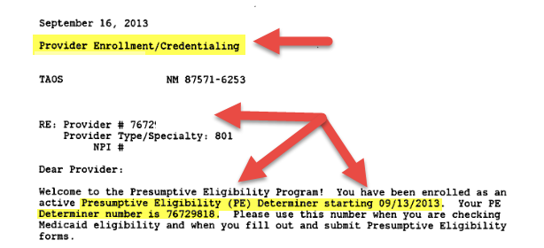
Welcome Letter
Some Key Points:
Each PE Determiner will receive a Welcome Letter. This letter will provide you with your NM Medicaid Number (also known as your PE Determiner number).
This Number is associated with you; it may be transferable if you change agencies (contact MAD PE Program Staff if you have question regarding transferring your PED number)
What to expect on your Welcome Letter:
Provider Enrollment / Credentialing
Name of certified PED
Address provided on the application (confirm with your organization what address to use)
NM Provider Determiner number and starting date.
PE Determiner Portal Registration Workshop

Slide 5
New Mexico Medicaid Portal Registration
Once you have completed the PE Determiner application process and received the welcome letter with your NM Medicaid PE Determiner number, you register as a user on the NM Medicaid Portal.
To register as a user on the NM Medicaid Portal, you will need your PED number. You may then go on-line to access the New Mexico Medicaid Web Portal Provider Registration page.
PE Determiner Portal Registration Workshop

Slide 6
Portal Provider Registration
https://nmmedicaid.portal.conduent.com/static/index.htm
On the Portal’s home page, click “Log in to:”
PE Determiner Portal Registration Workshop

Slide 7
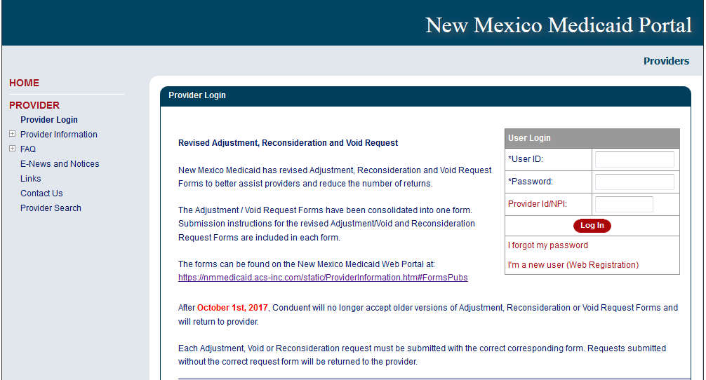
How to Register
Click “I’m a new user (Web Registration)”
PE Determiner Portal Registration Workshop

Slide 8
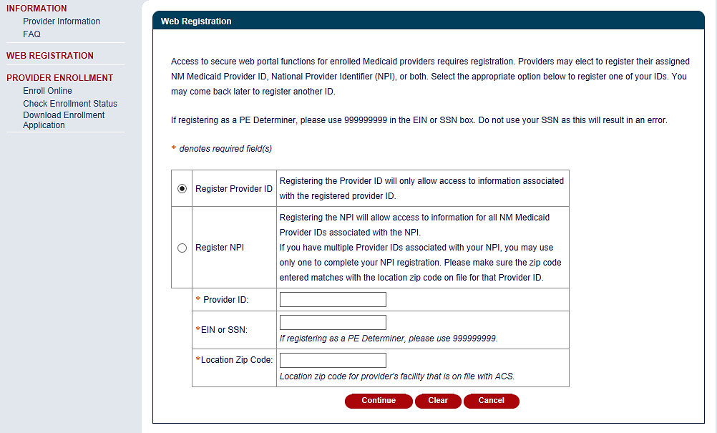
How to Register Continued
Use the PE Determiner number from your Welcome Letter.
Do not enter your SS#.
Use 999 99 9999, or you will get an error.
PE Determiner Portal Registration Workshop

Slide 9
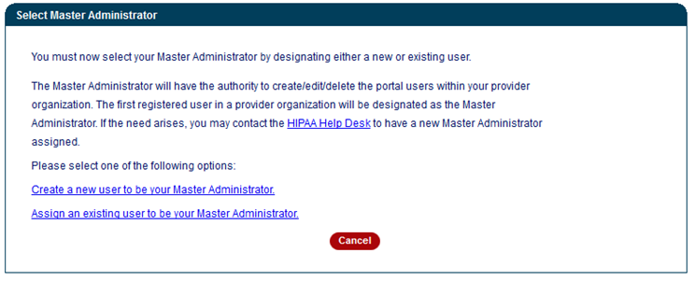
How to Register Continued
Click here to create a User ID on the web portal.
PE Determiner Portal Registration Workshop
Notes:
Speaker Note:

Slide 10
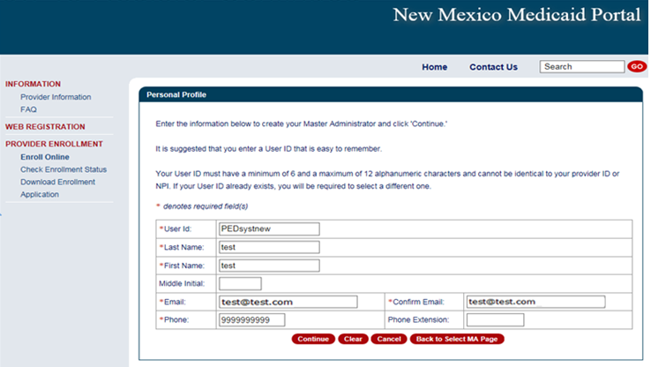
How To Register Continued
PE Determiner Portal Registration Workshop

Slide 11
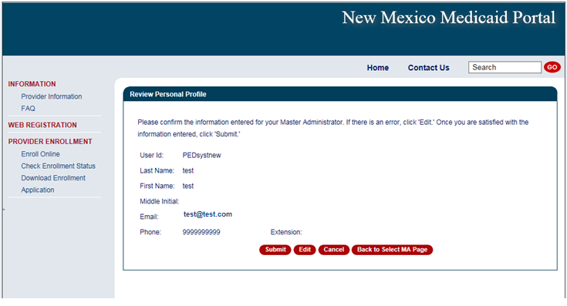
How To Register Continued
Once you have verified your information is correct click “Submit”
PE Determiner Portal Registration Workshop

Slide 12
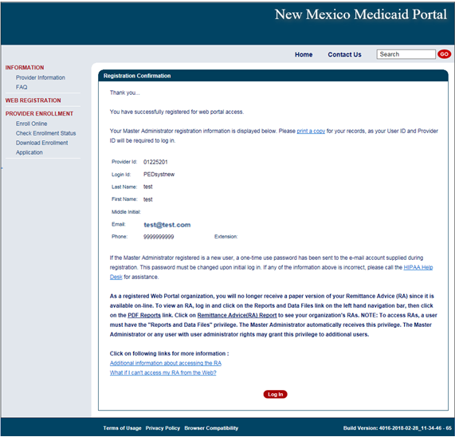
Registration Confirmation Page
NOTE: Write down your user ID before proceeding to the Log In page.

Slide 13
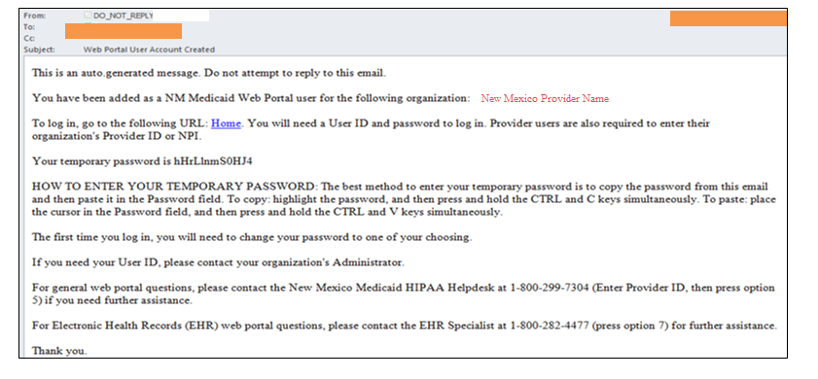
User Confirmation Email
Once you have registered, an initial password will be emailed to you:
PE Determiner Portal Registration Workshop

Slide 14
User Login
After you receive the user confirmation e-mail, you must log-in to complete your registration. To complete registration, you must enter:
Your User ID (created during the Web Registration process)
The initial password sent to you via email
Your PE Determiner number
When you log in for the first time, you will be required to change your
password. The password must meet certain standards that will be described to you on the web page.
PE Determiner Portal Registration Workshop
Notes:
Speaker Note:
If you lost or forgotten you newly created USER ID, contact the HIPAA Helpdesk for assistance.

Slide 15
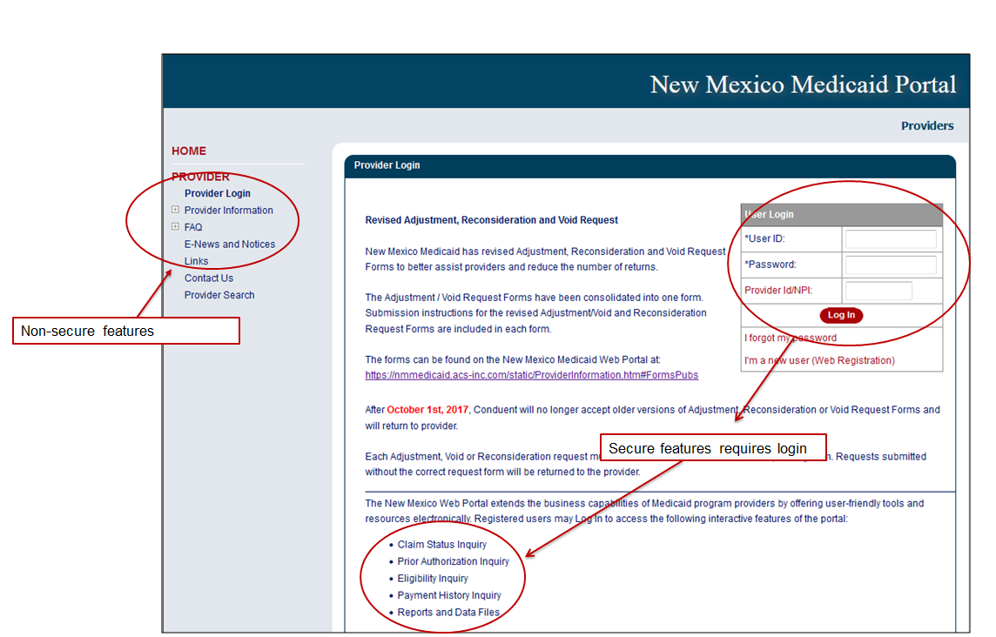
Web Portal Log In
PE Determiner Portal Registration Workshop
Notes:
Example:

Slide 16
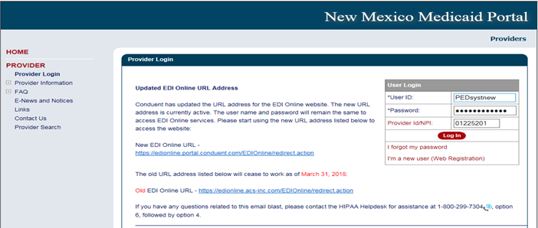
Logging In
Copy the temporary password from your confirmation email and paste it here
Type In your PE Determiner Number Here
PE Determiner Portal Registration Workshop

Slide 17
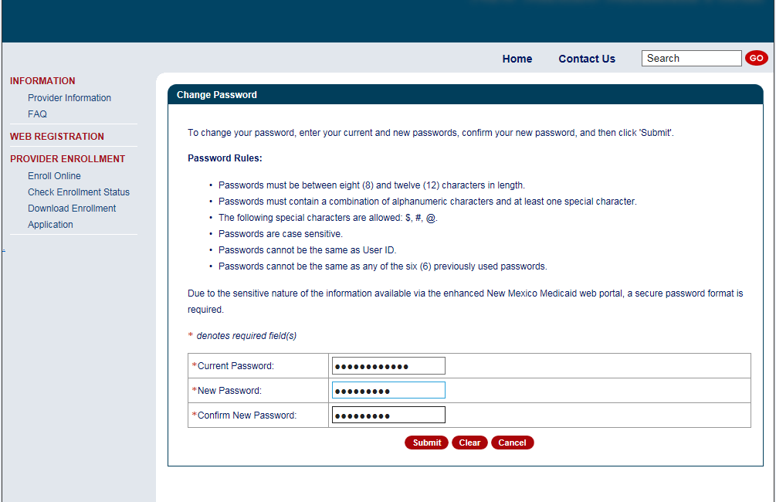
Changing Your Password
Please follow the Password Rules when customizing your new password.
Paste your temporary password one more time under “Current Password”.
PE Determiner Portal Registration Workshop
Notes:
Speaker Note: The most common error when changing the password is that people will accidently copy the space before or after the password in their email. The portal will consider the space as an extra character and will consider your password incorrect. Please double check that you didn’t accidently copy the space before or after the password.

Slide 18
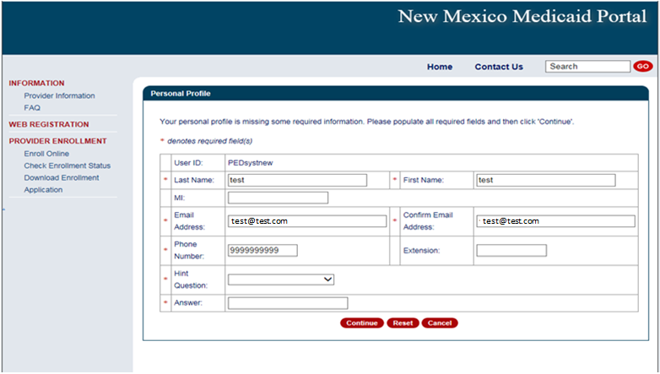
Personal Profile
Verify all your information is correct. If changes need to be made you can edit the field that needs to be changed.

Slide 19
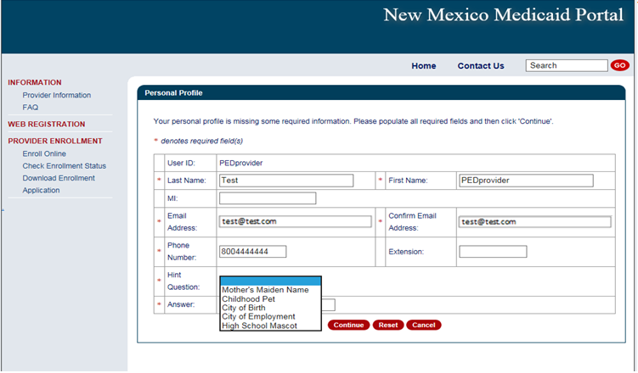
Security Questions for First Time Users
Select what you would like your security question to be.

Slide 20
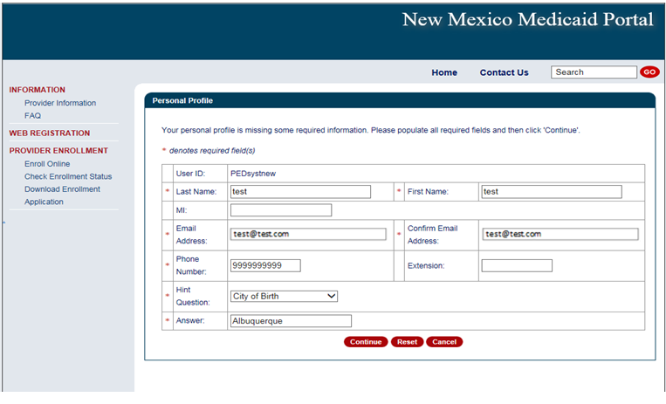
Security Questions for First Time Users
Please note your answers will be case sensitive. If you do not type your answer exactly as you did here, the portal will consider it a wrong answer.

Slide 21
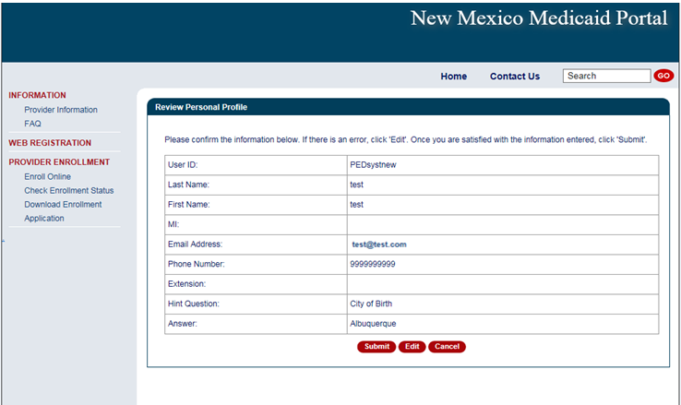
Review Your Profile
Please verify your information is correct. If corrections need to be made click “Edit”, otherwise click “Submit”.

Slide 22
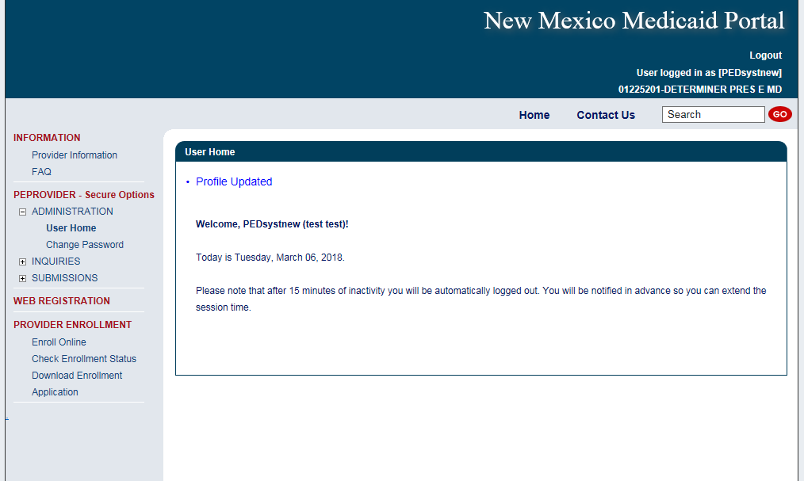
User Home
Once you reach this page, you have successfully logged in.

Slide 23
User Login – Forgot Password
If you forget your password click “I forgot my password”
PE Determiner Portal Registration Workshop

Slide 24
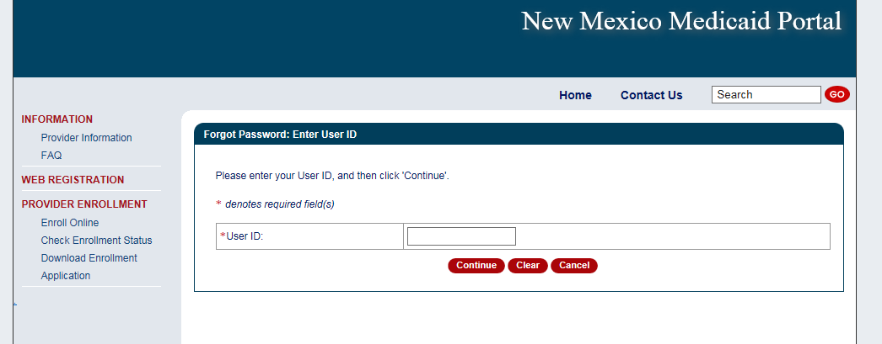
User Login – Forgot Password
Enter in your user ID and click “Continue”
PE Determiner Portal Registration Workshop

Slide 25
User Login – Forgot Password
Create your new password. The password must meet the rule circled above.
PE Determiner Portal Registration Workshop
Notes:
Pass word requirements

Slide 26
User Login Tips
After 15 minutes of inactivity, you will automatically be logged out of the Portal. If pop-ups are allowed, it will warn you that you will be logged out soon and give you the opportunity to click so that your session is extended and will not time out.
Sometimes you will miss the warning and be logged out.
You will need to change your password every 60 days.
You will be notified via e-mail four (4) days before the password expires and given an opportunity to change it every time you log in during those 4 days until you are finally required to change it.
PE Determiner Portal Registration Workshop

Slide 27
Resources - On the Portal
PE Determiner Portal Registration Workshop
Notes:
Click for more information or review Provider Login screen messages for Updates.

Slide 28
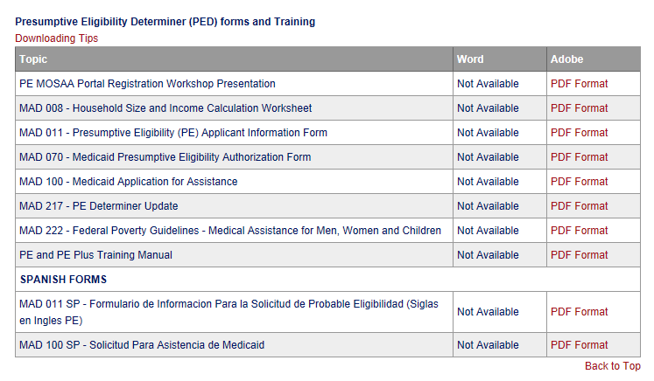
Resources On the Portal – PED Forms
PEDs must always use current PED Forms. The most up to date versions are available on the Portal:
https://nmmedicaid.portal.conduent.com/static/ProviderInformation.htm
PE Determiner Portal Registration Workshop

Slide 29
New Mexico Medicaid Resources
New Mexico Medicaid Online
Provider Information
Provider Login Screen Notices
Provider E-News Newsletters
Medicaid Provider Relations Call Center
Provider Communication Updates
Provider Field Representative
Provider Webinars
Open Forums and Live Training Sessions
Continued on next page . . .

Slide 30
New Mexico Medicaid Resources Continued
New Mexico Medicaid Portal – https://nmmedicaid.portal.conduent.com/static/index.htm
Claim Inquiries, Eligibility Verification, Electronic Claim Submission, Provider Manuals, E-News
NM Human Services Department – http://www.hsd.state.nm.us/mad/
Supplements, Memos, Provider Billing Packets and Policy
Medical Assistance Division – PE Program Staff – HSD.PEDeterminers@state.nm.us
Assistance with PE Applications, PE Determinations, MAD 070, PE Training, PE Certification
Consolidated Customer Service Center (CCSC) Helpdesk– (800) 299 - 7304.
Claim Status, Eligibility, Prior Authorization, Medicaid Updates
Consolidated Customer Service Center (CCSC) Helpdesk – NM.Providers@state.nm.us
Claim research assistance, general Medicaid inquiries, Provider Enrollment Applications, Forms & Instructions
HIPAA Helpdesk – HIPAA.Desk.NM@state.nm.us
Assistance on NM Web Portal, EDI inquiries, and Online Claim Submission with DDE (Direct Data Entry)
Consolidated Customer Service Center (CCSC) Helpdesk – (800) 283-4465
Eligibility inquiries, Fee-for-Service Replacement Medicaid Identification Card, Enroll or change a Managed Care Organization and Eligibility application status
Medical Assistance Division, Program Rules – http://www.hsd.state.nm.us/providers/rules-nm-administrative-code-.aspx
NMAC for Programs administered by the Medical Assistance Division Yes New Mexico - https://www.yes.state.nm.us/yesnm/home/index Apply, check, update, or renew Medical Assistance (Medicaid) benefits

